Slide 1
Lecture 1
CS494 – Information System Audit and Control

Slide 2
About Me
Syed Muhammad Ali
2006 – 2010: BS in Comp. Science from NUCES – FAST
2012 – 2014: MS – IT Management from UTS – Australia
2017 - MBA Ex. From IBA – Dropout
Have worked in AFF , Adamjee Life Assurance, K-Electric, Hilton Pharma
Currently Head of IT at Gerry’s FedEx.
Started career as an IT Auditor at A.F.Ferguson & Co. (PwC)
Gave my CISA examination and scored 2nd position in Pakistan

Slide 3
Why study IS Audit and Control?
Alternate career path for IT graduates (goal of this course).
Certifications like CISA CISM CRISC CGEIT CISSP etc offered by ISACA.
Internal audit, Information security, cyber security, risk management compliance etc.
Quite a big market nowadays especially in financial and multi-national companies.
Usually leads to top positions such as:
Chief Information Security Officer
Chief Risk Officer
Head of IT Audit etc.

Slide 4
What do you need to excel at IS Audit?
Good at comprehending English
Tech-savvy
Understand how information flows across systems
Be able to predict what can go wrong?

Slide 5
What is an audit?
To officially examine the financial accounts of a company.
An official inspection of an organization's accounts, typically by an independent body.

Slide 6
Why do we need to audit?
To form an independent opinion on the financial statements of the audited entity.
It’s a legal requirement for public companies etc..
Audits are conducted for a variety of reasons. An audit can help an organization ensure effective operations, affirm its compliance with various regulations and confirm that the business is functioning well and is prepared to meet potential challenges

Slide 7
Why IS Audit
What did we discuss in our first lecture?
To ensure the output from information systems is reliable.
To ensure the output from information systems is accurate.
To ensure the output from information systems is available when required.
Information systems are in compliance with applicable laws, regulations, contracts and/or industry guidelines.

Slide 8
Without an IT audit, can auditors rely on the financial statements they are being provided?
Notes:
Example of HR data being sensitive and not authorized?

Slide 9
Externa vs Internal Audits?
Not necessary that audits are only external.
External audits are carried out by independent 3rd party auditors.
Internal audits are carried out by the internal audit department of a company.
Every audit has a charter and a scope.
Our course takes the audit as a generalized term. Not internal or external.

Slide 10
Auditor Mindset
In God we trust, the rest we audit.
ISACA : In pursuit of Digital Trust.

Slide 11
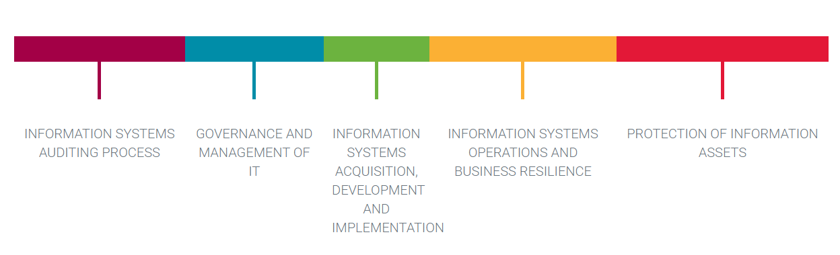
Areas we will cover during this course

Slide 12
Course books
ISACA CISA Manual – revises everything 4 -5 years.
CISA study guide – concise version for this course.
MCQ based CISA exam – Mids on same pattern – some theory some MCQs
Slides vs reading from book?

Slide 13
Chapter 1 Information Systems Auditing Process
CS494 – Information System Audit and Control

Slide 14
Audit planning
An audit plan is a step-wise approach to be followed to conduct an audit.
It helps to establish the overall audit process in an effective and efficient manner.
An audit plan should be aligned with the audit charter of the organization

Slide 15
What is an audit charter?
To understand the audit charter, we first need to understand how are companies structured.
What was the structure of Procom?

Slide 16
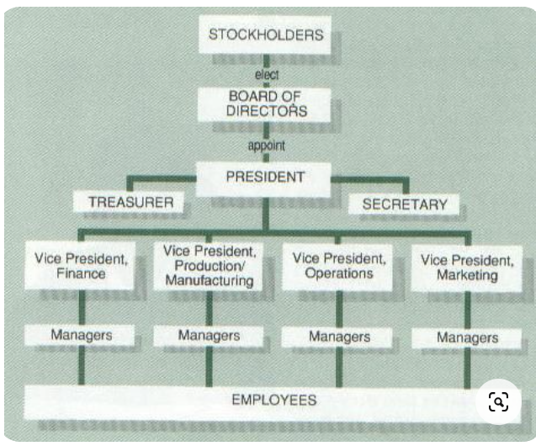
Sample company structure

Slide 17
Role of BOD
The BOD is a key component of the corporate governance framework, providing oversight and ensuring the company operates ethically and transparently
The BOD represents the interests of various stakeholders, including shareholders, employees, and the wider community.
The BOD appoints, evaluates, and compensates the Chief Executive Officer (CEO) and other top executives. It also engages in succession planning for key leadership roles

Slide 18
What is an audit charter?
An internal audit is an independent activity, and it should ideally be reported to a board-level committee, or the board itself.
Why?

